Slide 1

Part 6 – Programming Spark
Naren Thilla
June 12th 2015

Slide 2
Agenda
Spark Introduction
Basics of Spark Programming
Real world programming using Spark
Understanding Spark Clusters
Spark Streaming
Spark SQL

Slide 3
Introduction to Spark

Slide 4
The Problem of Distributed Computing
Common Techniques for computing in distributed mode.
Distilling Map and Reduce from the above techniques.
What is a Map?

Slide 5
From MR to Spark
What is a Map?
The foundations of Map
Basics of MR Programming
Input->Map->Sort->Shuffle->Merge-> Reduce ->Output
Limitation of Hadoop MR
Programming constructs complex to implement
Results in lot of I/O (95% of MR is moving data and 5% compute)
Pipelining difficult to achieve
Enter Spark
Operations performed in Memory (Distributed memory)
=> 100x performance improvements
Richer Programming Constructs
Commonality between MR & Spark
Distributed Network & Fault Tolerance
Linear Performance
Open Source (Apache License), Large community etc
Leverages HDFS and other Hadoop ecosystems
Caution:
Spark may not be the silver bullet for all.
Do not use when the dataset is >> total aggregate memory
Can result in Pagination and slower througput

Slide 6
API
(Hadoop MR like, but simpler and richer)
Resource Management (Spark, YARN, Mesos)
Compute Engine (Spark)

Slide 7
Spark Shell & Scala
Built in Context called Sc (spark context)
Invoke the spark shell $spark-shell

Slide 8
Exercises
Ex 1: Text File RDD
Ex 2: Whole File RDD
Ex 3: Map & Filter Transformation

Slide 9
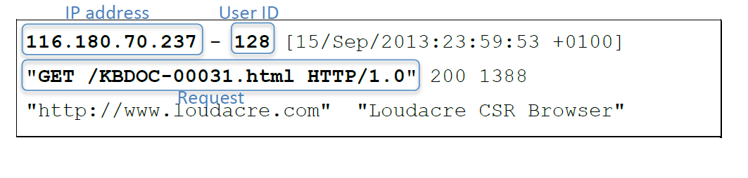
Introduction to the Data Set

Slide 10
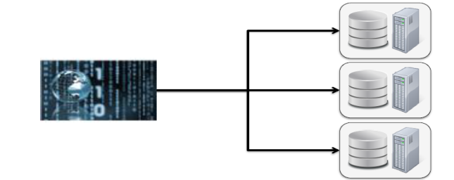
Ex 1: Resilient Distributed Dataset (RDD)
Provides a uniform single point abstraction for the distributed dataset
Resilient (Can be built if memory is lost) & Distributed
RDDs are the functional unit of Spark
RDDs can be created from:
- From File
- From memory
- From another RDD
Key Learnings:
Load from local File: use “file:/….”
Load from HDFS: use “hdfs:<host:8020>/file…”
Var vs. Val
How does this operation compare to MR?
spark-rdd.txt

Slide 11
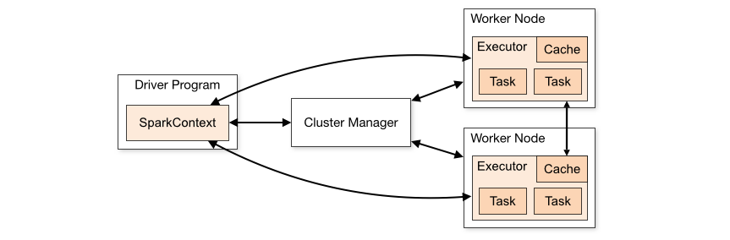
Spark – Cluster Overview
Cluster Managers:
Standalone
YARN
Mesos
Reference: https://spark.apache.org/docs/latest/cluster-overview.html

Slide 12
Spark – Cluster Manager
Worker Node -1
Storage Grid – HDFS
Partition -1
Partition -2
Spark Driver
Cluster Manager
Spark Context
Compute Grid
Executor -1
Executor-2
Worker Node -2

Slide 13
Data Pipelining – MR in Spark
Hadoop MR allows only one map & reduce per job.
This results in lot of wastage (I/Os) . Chaining of operations is not possible.
Spark allows combining of Map & Reduce
This results in incredible performance boost

Slide 14
Ex 2: Text File && WholeTextFile RDD
Use of wildcard for textFile permitted
The resultant RDD will contain ALL the lines.
The lines are terminated by “\n”
For local files, the same file must be accessible to all the worker nodes (Staging and mounting the staging drive is a better option!!)
Internally the work as well as the data set is divided across multiple nodes.
There is a 1:1 relationship between HDFS blocks and Spark Partitions.
You can ask for more partitions, but not less
How to view Partitions rdd.partitions.length
How to increase Partitions
Sc.wholeTextFiles() returns [k,v] where k is the file name and v is the dataset corresponding to the file.
Ex: spark- WholeTextFile.scala

Slide 15
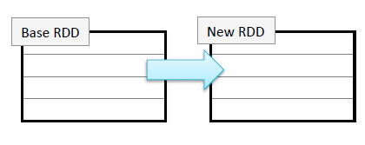
Exercise 3: Map and Filter Transformation
Base RDD is immutable
Transformation create a modified version of RDD
Map (f)
Filter (f)
Syntax: RDD.map (element=>element.function)
Lazy Loading
Chaining Transformations allowed
Compare with Chaining of Map Jobs
Data Pipelining & Stages in Spark
Example of Map : Convert to Upper Case (spark-toUpper.scala)
Example of Reduce: Filter out all lines starting with empty space (spark-filterForI.scala)
DIY: Visualize the MR equivalent

Slide 16
Ex 4: Further Transformations- Zip, Values
Zip
Map
Values
Zip: Rips the ith element from each partition and combines them side by side
Example : Spark-zip.scala

Slide 17
Ex: Web Log Processing
Sample Weblog
Objective:
You are given ~ 1.08M weblogs.
Extract IPAddress/UserID for HTML logs
Find how many unique visitors visited? Ans. 35K
How many unique IP addresses did the users visit from? // 474K
Provide a daily chart of the following:
Date | Total # of visits (Based on IPAddress) | Total unique visits (based on IP Address) | Total unique visitors (Based on User ID)
15th Sept 2015 | 100K | 35K | 30K
16th Sep 2015
Ex: spark-weblogs.scala

Slide 18
The lifecycle of a Spark Program
Step 1: Create an RDD
Step 2: Define functions (optional)
Step 3: Do Transformation on RDD
Remember, this operation will be performed lazily.
Cache (optional)
Step 4: Do actions and analysis
Step 5: Print/Save the results

Slide 19
A Deeper look at RDD
What does an RDD contain?
Primitives – int, char,boolean
Sequences – String, List, Array, Tuples, Dict
Objects – Scala/Java Objects
Mixed
Iterators !!
val data = Array(1, 2, 3, 4, 5)
val distData = sc.parallelize(data)
Val rdd = sc.parallelize (Array(1,2,3,4,5))
Val rdd = sc.parallelize (List(1,2,3,4,5,6), 2)

Slide 20
RDD Operations
Two types of RDD Operations :
Transformation
Map(k=>k’)
GroupBy ()
Filter
flatMap
Distinct
Union
Zip
Ex: spark-odd-even.scala

Slide 21
RDD Operations
Actions
First, foreach, top(n), take(n)
count() – Returns the count of RDD
take(n) – Returns an Array of n elements
collect()- Returns an Array of all elements (Can be expensive) – use with care!
saveAsText(file)
Sampling
Sample (withReplacement, percent) takeSample(percent)
Useful for unit testing
Double RDD operation
Stat functions such as mean, sum, stdev etc
Ex: spark-sample.scala
Notes:
http://markmail.org/message/jogee653ef2xjjts
http://www.ma.utexas.edu/users/parker/sampling/repl.htm

Slide 22
Function Programming – The UDFs of Spark
Function Programming
No Side Effects
Use of def
def toUpper(s: String): String = { s.toUpperCase }
RDD.toUpper().take(10)

Slide 23
RDD Lineage
RDDs are not mutable.
RDD operations result in a child RDD
RDDs are chained by a parent-child relationship
Rdd.toDebugString() prints the RDD lineage.

Slide 24
Spark -Cache
RDDs do not cache the data automatically.
When an action is performed, the memory used by the RDD is torn down.
Why?
Use rdd.cache() to cache the data set
When to use cache?
When you want to run multiple operations on the underlying data set.
Ex: doing a project on wikipedia –India specific “pages”.
When you wish to maintain hot-data
Segue: http://www.attunity.com/blog/hot-warm-cold-which-data-should-you-move-hadoop
When not to cache?
When datasets are larger than the collective memory available
When you want to throwaway the underlying dataset after a single use.
Note: RDDs are immutable. You always get a child RDD when you transform. So, cache the right data-set !!
Ex: spark-cache.txt

Slide 25
Map, FlatMap, Union, take(n), collect() etc
This is Oct 2nd and today is a holiday
This is the day on which the Mahatma was born
This
is
Oct
2nd
and
val fileRDD = sc.textFile(file)
val mapRDD = fileRDD.map(line=>line.split(‘ ‘))
//Map vs. FlatMap
val flatMapRDD = fileRDD.flatMap(line=>line.split(‘ ‘))
//So, how do we access them?
mapRDD.take(1).foreach(t=>println((t(0) )))
flatMapRDD.take(1).foreach(t=>println(t))
// Note: From windows to unix, the ‘ ‘ will not transpose correctly.
was
born

Slide 26
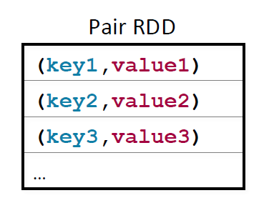
Pair RDDs
Pair RDDs
Key Value Pair
Helpful to be used with MR
Sorting, joining, grouping, counting
Common Key functions
Map, flatMap, flatpMapValues,keyBy
Constructing a pairRDD
Users=sc.textfile(file).map(line=>line.split(‘ ‘).map(fields=>fields(0), fields(2))
Ex: spark-pair-rdd.scala

Slide 27
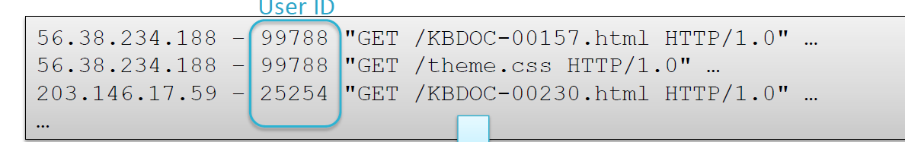
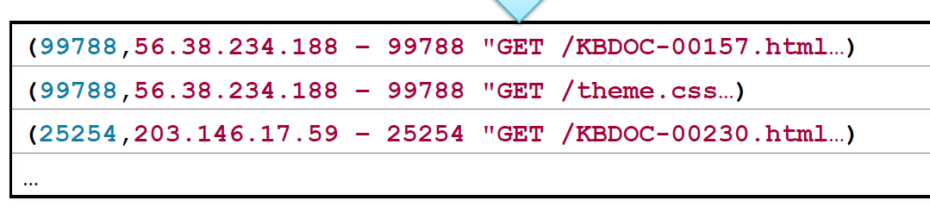
KeyBy,
Sc.textfile(file).keyBy(line=>line.split(‘ ‘) (2)

Slide 28
WordCount – The Spark Way
The quick brown fox jumps over and over the lazy dog
The | 1
Quick | 1
Brown | 1
Over | 2
Note: val wcRDD = fileRDD.map(word=>word.split(' ')).map(fields=>(fields(0),1)).reduceByKey((key1, key2)=>key1+key2)
Ex: spark-wc.txt
Qn: What if you want to print (filename, # of lines)?
Hint: use sc.wholeTextFiles(“/user/cloudera/weblogs/*log")

Slide 29
Additional RDD functions
Other Pair RDD operations
Keys – Returns the keys from the pair RDD
Values – Returns the values from the pair RDD
Lookup(key) – Returns the value(s) from the pair RDD
mapValues - execute a function
flatMapValues- execute a function and flatten the resultant dataset

Slide 30
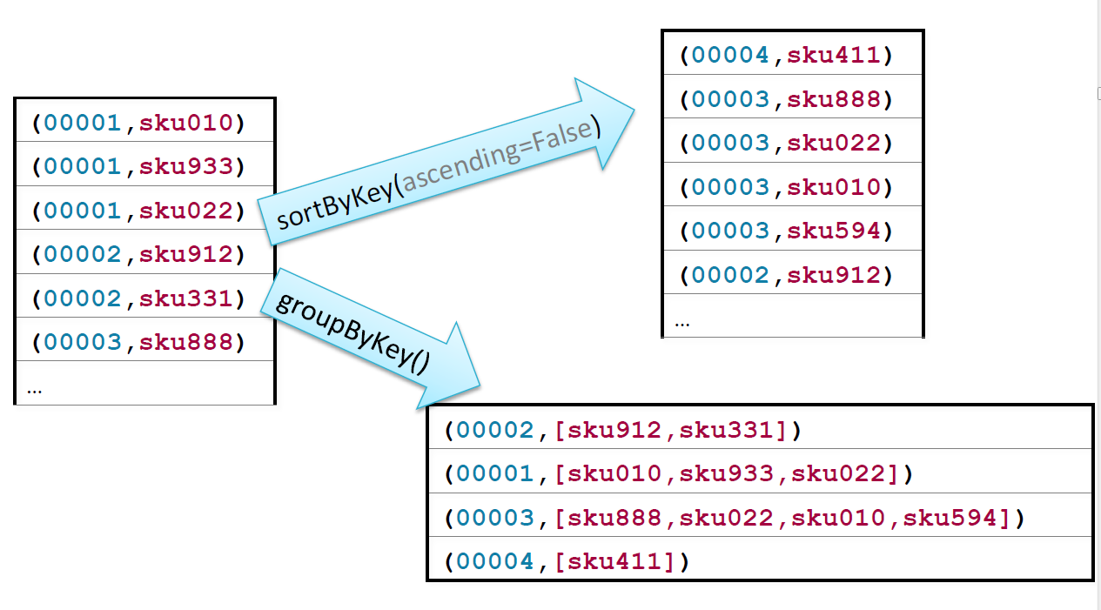
sortByKey, groupByKey

Slide 31
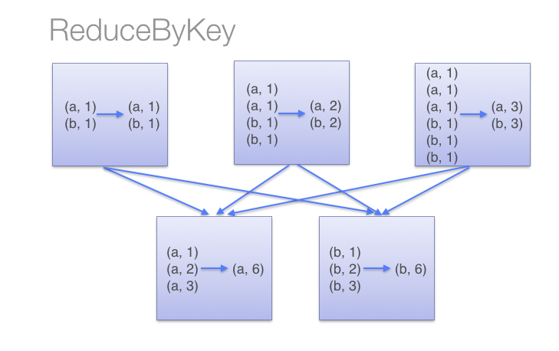
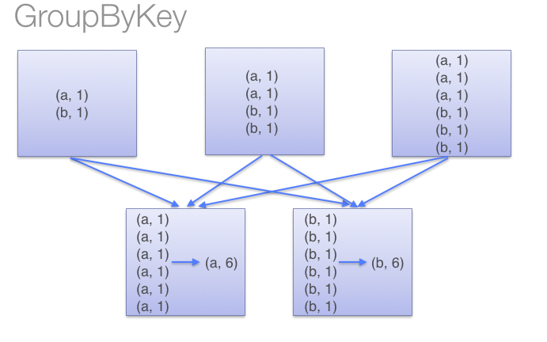
When to use what?
Prefer ReduceByKey over GroupByKey
http://databricks.gitbooks.io/databricks-spark-knowledge-base/content/best_practices/prefer_reducebykey_over_groupbykey.html
Source: DataBricks

Slide 32
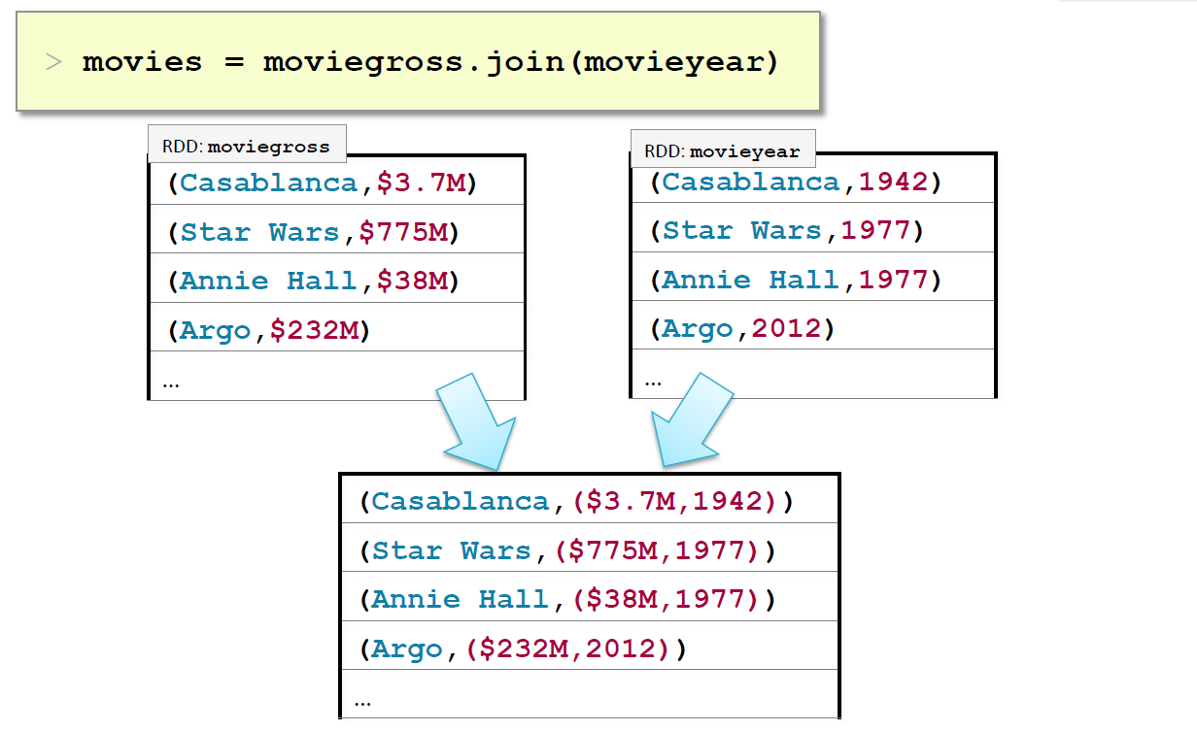
Join

Slide 33
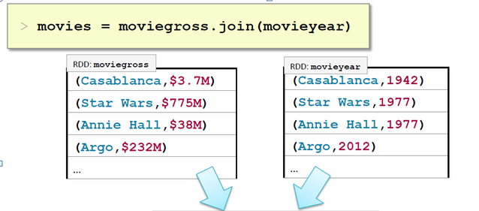
union
(Casablanca,( $3.7M)
(Stars Wars, $775)
(Annie Hall, $38M)
(Argo, $232M)
(Casablanca,1942)
(Star Wars, 1977)
Ex: scala-
movies.scala

Slide 34
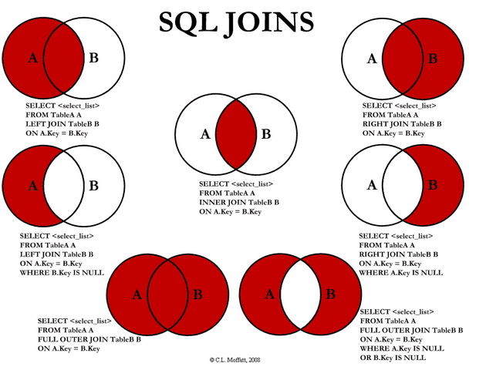
Ex: spark-join.scala

Slide 35
Exercise II
MovieLens Dataset
Use of Join, Union etc
Ex: Spark– movies.scala
Data set: z:…\movie data\ml-latest-small

Slide 36

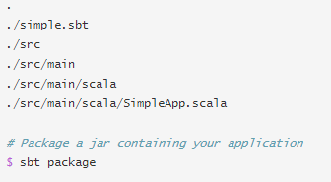
Running Spark App – Sandbox Instructions
Install sbt: yum install sbt
Write your code – SimpleApplication.scala
Write the sbt file – simple.sbt
Arrange the files in the folder
Run it:
spark-submit --class "SimpleApp" --master local[4] \ target/scala-2.10/simple-project_2.10-1.0.jar
Ex: \...code\spark\application\src\main\scala\SimpleApplication.scala
Sbt file - \...\simple.sbt

Slide 37
Interactive Analysis – K-means clustering

Slide 38
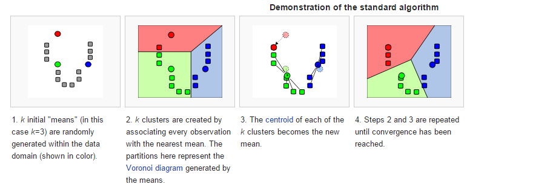
K-Means Clustering
This is an NP-Hard Problem (Non-Deterministic in Polynomial time).
Heuristic algorithms are considered for the same.
Choice of K is important for faster convergence
Source: Wikipedia

Slide 39
K-Means Cluster - Algorithm
Let X = {x₁,x₂,x₃,……..,x_{n}} be the set of data points and V = {v₁,v₂,…….,v_{c}} be the set of centers.
1) Randomly select ‘c’ cluster centers.
2) Calculate the distance between each data point and cluster centers.
3) Assign the data point to the cluster center whose distance from the cluster center is minimum of all the cluster centers..
4) Recalculate the new cluster center using:
where, ‘c_{i}’ represents the number of data points in i^{th} cluster.
5) Recalculate the distance between each data point and new obtained cluster centers.
6) If no data point was reassigned then stop, otherwise repeat from step 3).
Ex: spark-k-means.scala
Dataset: <statuslist>

Slide 40
Results
36.403171752604756,-119.89983102088591 – RiverDale, CA
44.23449040206693,-121.8004293853695 - Trail Blue River, OR
34.18840233263631,-117.68588190183058, Claremont, CA
38.53179844863589,-121.28922634614136 - ~ Oroville, CA
35.08592000544959,-112.57643826547951- Ash Fork, AZ
val zipRDD = sc.textFile(“/user/cloudera/zip/zipcode.csv”).filter(s=>!s.startsWith(“”))
Val resRDD = zipRDD.map(s=>s.split(“,”)).filter(s=>s(3).equals(“36.4”).filter(s=>s(4).contains(“-119.8”)
resRDD.collect().foreach(s=> println (s(0) +":" + s(1) + ":" + s(2) ) )

Slide 41
Playing with the Yelp Dataset
http://www.yelp.com/dataset_challenge
https://www.yelp.com/academic_dataset

